Slide 1
CLasteroids
Course project for csci 352
By Philippe Lumpkin and Nicholas Pica

Slide 2
Background
What is this project?
This project was designed to be a remake of the game Asteroids.
Why did we do this project?
Both of our histories have included gaming as we both began playing on the PlayStation 1 and 2.
What do you need to know about this project?
Our first intention was to create a complete remake but shortly after beginning we decided to instead create our own version of the game.

Slide 3
Approach
How did we do it?
This game was created in a C# WPF.
Special libraries/drivers?
A major library that we have added to the program is the Threading library.
We added the IO library that allowed us to read from a file.
Design Patterns used?
We specifically used the State and the Observer pattern.

Slide 4
Class Diagrams
This project begins with a main window in which pages are hosted inside of it.
We then use navigation methods to transition to our pages.
Then we have four different classes that can be navigated to(StartScreen, GameScreen, HighScoreScreen, and GameOverScreen).
Most of the game lives within the GameScreen, essentially most of the main functions for everything.
Each of the other screens house the Start menu, High Scores and the Game Over screen respectively.

Slide 5
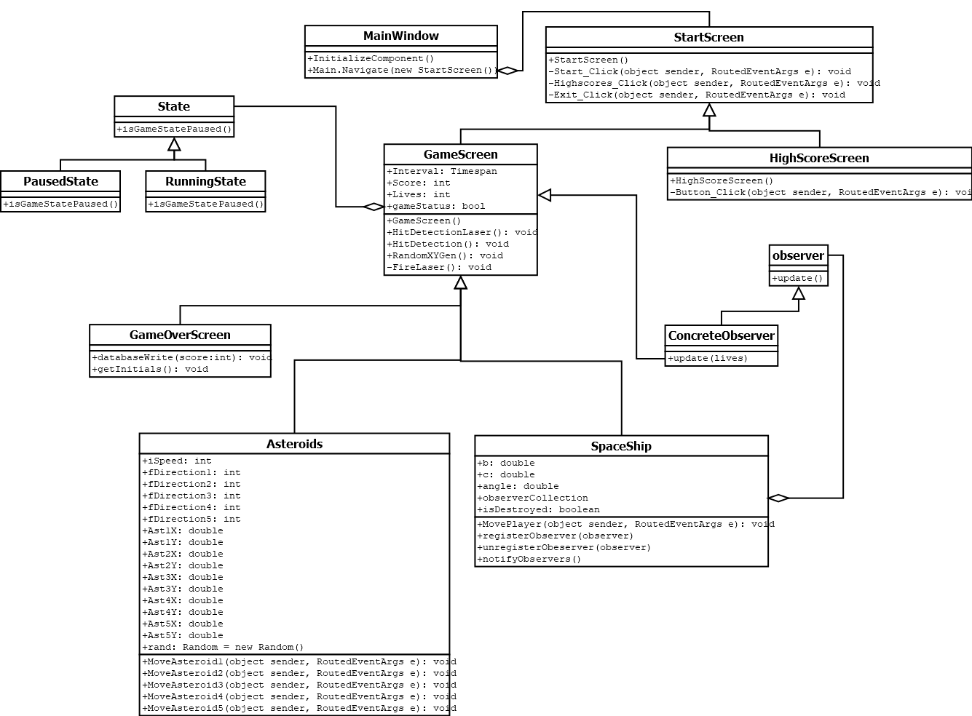

Slide 6
Demo Time!

Slide 7
Future Work
We would both like to take our knowledge gained from this project and code our versions of some other older arcade games.
It would also be nice to convert the CLASTEROIDS project over into a different engine and not use a WPF, as WPFs are not really intended for games.

Slide 8
Questions?
phiglump@ut.utm.edu
nicapica@ut.utm.edu
GitHub: https://github.com/phiglump/Asteroids

